Slide 1
Quantifying Rhetoric
Open Data Science Conference East, Boston 2016
#ODSC

Slide 2
The Plan
Talk
Introductions
Put It All Together and Play
Wrap Up
Code

Slide 3
HELLO
my name is
I work at …
Emily Schumm
My favorite part of my job is …
Teaching
I started Python…
In college, but I really picked it up more once I started working.

Slide 4
Meet My Thought Process
Presidential debates are funny
NLTK allows us to parse text easily
Let’s parse debates with Python and turn it into a comedy routine
Check out http://www.cnn.com/2015/12/16/politics/republican-debate-by-the-numbers/

Slide 5
Meet the Idea
What if we could compare speeches and speakers to see if we can find any patterns, similarities, trends, etc?

Slide 6
In Their Words: Rhetoric Is…
“The art of winning the soul by discourse.”
Plato
"Rhetoric is one great art comprised of five lesser arts: inventio, dispositio, elocutio, memoria, and pronunciatio.”
Cicero
"Rhetoric is the art, practice, and study of human communication.”
Andrea Lunsford
"[Rhetoric,] that powerful instrument of error and deceit.”
John Locke
"This [is the] sine qua non of rhetoric: the art of linguistically or symbolically creating salience. After salience is created, the situation must be translated into meaning.”
Richard E. Vatz (Philosophy and Rhetoric, 1973)

Slide 7
Mediums of Rhetoric
 | Body Language | Tone | Diction
In Person | X | X | X
Audio |  | X | X
Written |  |  | X
We will only be looking at written form (even if speech itself – most were – was delivered in person)
Kennedy vs Nixon

Slide 8
What We Want
Parse the speech
Determine features to extract
Extract features
Look for patterns

Slide 9
What We Need
Domain Expertise
Computer Science
Mathematics
Linguistics Basics
Rhetorical Devices
Python
NLTK (language processing)
Pandas (data structures)
Algorithms to find patterns, relationships
Visualization knowledge

Slide 10
What We Will Do
Acquire
Prepare
Analyze
Act

Slide 11
Acquire
Obtaining the Data

Slide 12
Acquiring Texts
Getting raw text is no small feat
We cheated and copied and pasted text
Many of the places that store speech transcripts are trying to be read friendly, not parse friendly
Bottom Line: A lot of work can go into figuring out how to get your data and clean it so it’s ready for game time

Slide 13
Prepare
Conditioning data to fit needs

Slide 14
Normalizing Text
I have nothing to offer but blood, toil, tears and sweat.
!=
i have nothing to offer but blood, toil, tears and sweat.

Slide 15
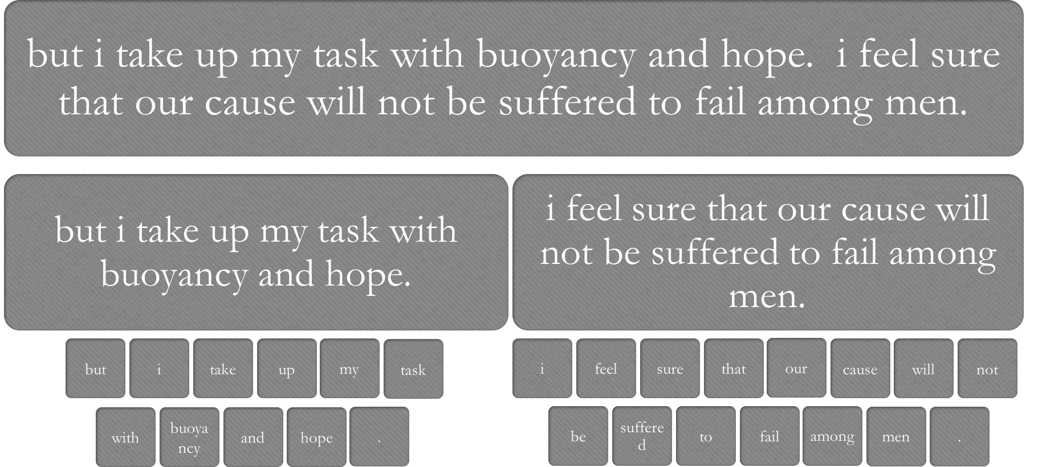
Tokenization

Slide 16
Natural Language Toolkit
Python meets Human Language Data
Over 50 Corpora
Handles multiple languages
Packages to assist with
Tokenization
Parsing
Stemming
Classification
Semantic Reasoning
... and more

Slide 17
NLTK Basics
nltk.sent_tokenize: parses string into list of sentences based on default separators
nltk.word_tokenize: parses string into list of tokens based on default separators

Slide 18
Notebook 1
NLTK Basics
Notes:
45 minute mark during rehearsal
Then give 10 minutes to play with various speeches

Slide 19
Notebook 2
Representing Text in Pandas
Notes:
15ish?

Slide 20
Guided Exercise 1
Applying What We Have Learned So Far
Notes:
Give 20 minutes for this

Slide 21
What’s In a Word?
rhetoric
(ˈrɛtərɪk)
n
1. (Rhetoric) the study of the technique of using language effectively
2. (Rhetoric) the art of using speech to persuade, influence, or please; oratory
3. excessive use of ornamentation and contrivance in spoken or written discourse; bombast
4. speech or discourse that pretends to significance but lacks true meaning: all the politician says is mere rhetoric.
[C14: via Latin from Greek rhētorikē (tekhnē) (the art of) rhetoric, from rhētōr rhetor]
Collins English Dictionary – Complete and Unabridged, 12th Edition 2014 © HarperCollins Publishers 1991, 1994, 1998, 2000, 2003, 2006, 2007, 2009, 2011, 2014

Slide 22
Linguistics
A brief overview from a relative novice

Slide 23
Aspects of Linguistics
Morphology
Syntax
Semantics
Writing systems
Phonetics
Phonology

Slide 24
Writing Systems
determine how language is visually represented.

Slide 25
Phonetics
studies the production of speech sounds by humans.

Slide 26
Phonology
is about patterns of sounds.

Slide 27
Morphology
is the study of word formation.

Slide 28
Morphemes
A morpheme is a unit of meaning
Some words are a morpheme in themselves
Most words have several morphemes
Playfully = play+ful+ly
Antidisestablishmentarianism =
anti + dis + establish + ment + ari + an + ism
Free morphemes are morphemes that can be used by themselves. They have meaning on their own.
-girl-boy-house-peace-
Bound morphemes cannot stand on their own
-ful-ish-ly-
Open Class/Content Words
Have a standalone meaning
Words for people, things, attributes
New words can be added
Closed Class/Function Words
Do not have clear lexical meaning Conjunctions, articles, prepositions, pronouns, etc
New words generally not added
morphemes
bound
affixes
roots
free
Open class content words
Closed class function words
Bound roots are the dominant morphemes of a word but have no meaning on their own.
-re+ceive-
Affixes can be added to one or both sides of a word in order to add meaning.

Slide 29
Syntax
describes how words are put together to form phrases and sentences.

Slide 30
Lexical Categories = Parts of Speech
Part of Speech indicates a word’s role in a sentence structure
They also have associated rules for how they can be combined
Noun
Verb
Adverb
Pronoun
Adposition
Adjective
Determiner

Slide 31
Tree Diagrams Determining Meaning
S
NP
VP
V
I killed a mouse in my pajamas.
(I) (killed a mouse in my pajamas)
(I) (killed a mouse) (in my pajamas)
Noun
NP
Prep
NP
(a) (mouse) (in) (my pajamas)
Determiner
N
(my) (pajamas)
PP
Det
N

Slide 32
Semantics
is the study of meaning in language.

Slide 33
Key Terms
Lexeme
Lexicon
Lemma
A written or oral word paired with its meaning
A finite list of lexemes
The grammatical form used to represent a lexeme
Part of speech specific

Slide 34
Lemmas to Lexemes
Lemma
Lexeme
running
run
are
be

Slide 35
Things That Are Alike
Homonymy
Synonymy
Form 1
Form 2
Meaning 1
Meaning 2
Bass (fish)
Bass (voice part)
Small
Little

Slide 36
WordNet http://wordnetweb.princeton.edu/perl/webwn
Lexical database
Features synsets, groupings of ‘cognitive synonyms’
Linked by semantic and lexical meanings
Sort of like a thesaurus
Largely POS dependent
Created and cultivated at Princeton University
Part of NLTK corpus

Slide 37
Application
Using linguistics

Slide 38
Ngrams
Group sequential words together
Bigrams - sets of 2
Trigrams - sets of 3
“my favorite food is potatoes”
Bigrams- (my, favorite) (favorite, food) (food, is) (is, potatoes)
Trigrams- (my, favorite, food) (favorite, food, is) (food, is, potatoes)

Slide 39
Ngrams
Ngrams are used in a variety of nltk tools in order to provide context for a word
Context: get word before and after
Collocations: get words within a window
Most probabilistic models use some version of ngrams to determine conditional probabilities

Slide 40
Stemming vs Lemmatization
Both are used to determine equivalency between tokens
Stemming is a heuristic
Ranging -> Rang
Lemmatization uses vocabulary and morphological analysis
Ranging -> Range

Slide 41
POS Tagsets
A tagset is a set of tags used for lexicon that associate a lexeme to a part of speech.
Common Tagsets
Upenn
Universal
Stanford
…and more

Slide 42
How Tags Are Applied
Feature Extraction
Classification
Rule-based
Learning-based
Morphological
Semantic

Slide 43
Features
Morphological features might be…
-ly means adverb
Rule based vs Probability based
Suffix
Prefix
POS

Slide 44
Notebook 3
Pos, Stem, and Ngrams
Notes:
25 minutes after this point (1:05 total)

Slide 45
Rhetoric

Slide 46
In Their Words: Rhetoric Is…
“The art of winning the soul by discourse.”
Plato
"Rhetoric is one great art comprised of five lesser arts: inventio, dispositio, elocutio, memoria, and pronunciatio.”
Cicero
"Rhetoric is the art, practice, and study of human communication.”
Andrea Lunsford
"[Rhetoric,] that powerful instrument of error and deceit.”
John Locke
"This [is the] sine qua non of rhetoric: the art of linguistically or symbolically creating salience. After salience is created, the situation must be translated into meaning.”
Richard E. Vatz (Philosophy and Rhetoric, 1973)

Slide 47
Canons of Classical Rhetoric
Inventio
Invention
Discovery/research of arguments
Dispositio
Arrangement
Select and arrange arguments
Elocutio
Style
Correctness, clearness, appropriateness, ornament
Memoria
Pronuntiatio
Memory/recollection
Delivery (downplayed in classic thought)

Slide 48
Elocutio’s Style – lots of overlap
Figures of Speech
Artful patterns and arrangements in language
Syntactic in Nature
Parallelism
Alliteration
Assonance
http://users.wfu.edu/zulick/454/figures/tropesindex.htm
Tropes
Use of figurative language, substituting one idea/term for another
Semantic in Nature
Metaphor
Metonymy
Synecdoche
Irony
Hyperbole

Slide 49
Trope: Rhetorical Question
What is it?
A question asked for some purpose other than to acquire information
“Why oh why me?”
“Who do you think you are?!”
How can we find it?
Our texts are monologues
Any question is not expected to be answered
Look for sentences ending in “?”

Slide 50
Figure: Epitrophe
What is it?
Ending successive phrases in similar manner
“What lies behind us and what lies before us are tiny compared to what lies within us." —Emerson
How can we find it?
Just a single word repeating is not epitrophe
We need to look at the sentence structure
If surrounded by the same parts of speech, consider epitrophe
Should consider looking within a sentence and between successive sentences

Slide 51
Figure: Alliteration
What is it?
The occurrence of the same letter or sound at the beginning of adjacent or closely connected words
“"They are part of the finest fighting force that the world has ever known. They have served tour after tour of duty in distant, different, and difficult places... —Obama
How can we find it?
Look for successive words with similar sounds
Same two first letters
Same first vowel
Same first consonant followed by a vowel
Remove stop words
Look for successive words and words one apart

Slide 52
Figure: Epenalepsis
What is it?
Repeating the same phrase at the beginning and end of a phrase
“Believe not all you can hear, tell not all you believe." —Native American proverb
How can we find it?
You Try

Slide 53
Figure: Polyptoton
What is it?
Repeating a word in a sentence, but in a different form (think lemma vs lexeme)
“The Greeks are strong, and skillful to their strength, fierce to their skill, and to their fierceness valiant” -- Shakespeare
How can we find it?
You Try

Slide 54
Figure: Chiasmus
What is it?
Reordering parallel grammatical structures in a sentence/phrase
"Ask not what your country can do for you; ask what you can do for your country." John F. Kennedy
How can we find it?
You Try
Notes:
10 minutes after this

Slide 55
Notebook 4
Detecting Rhetorical Devices

Slide 56
The Profile
Extracting the Metrics of a Speech

Slide 57
What Have We Discussed?
Tokens
Diversity Ratio
Parts of Speech
POS Distribution
Rhetorical Devices
Clauses
Length of sentences
Length of words
Rhetorical Question
Alliteration
Epitrophe
Amplifiers
Sequence
Conclusion

Slide 58
How will we normalize counts?
Speeches have different lengths
Pretty rudimentary
If counted per sentence, will be divided by number of sentences
If counted per token, will be divided by number of tokens

Slide 59
Notebook 5
Putting It All Together B

Slide 60
Analysis
Finding patterns and trends

Slide 61
Biases
Only selected certain features
Shorter speeches have less occasion for devices (even with normalization)
We wrote the feature selection
Sure to have false positives and false negatives

Slide 62
Notebook 6
Demos (you don’t have this)

Slide 63
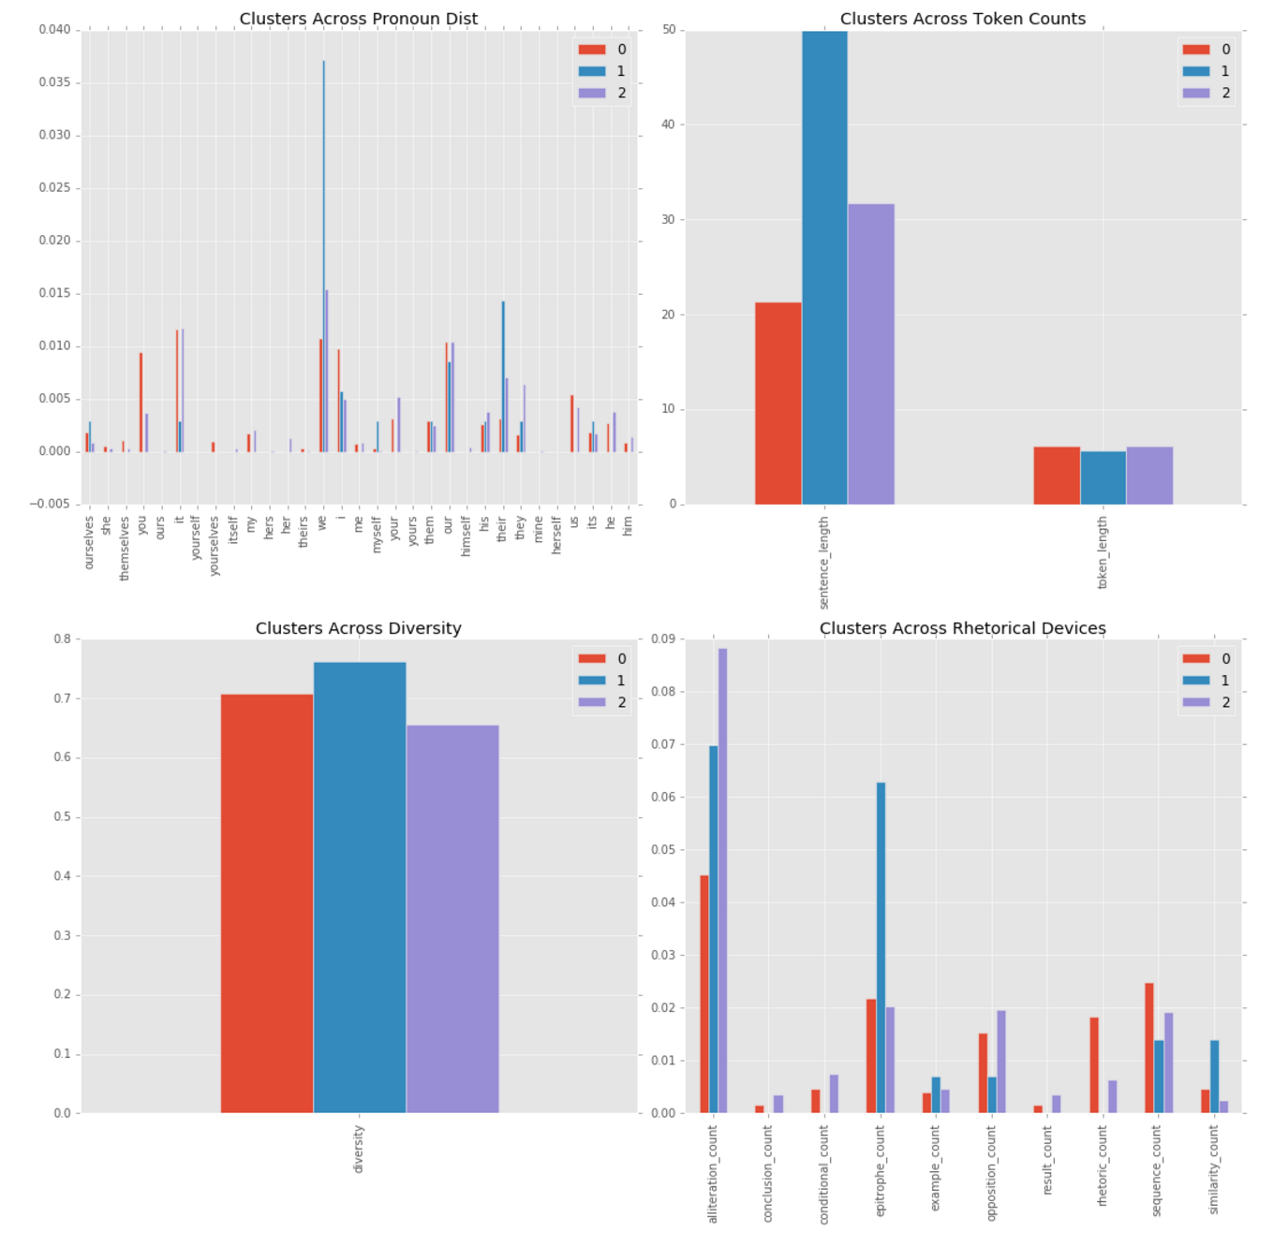
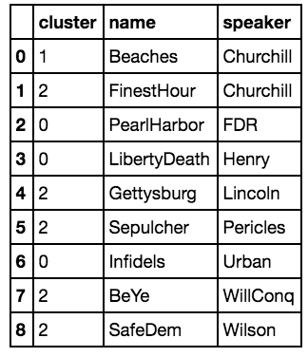
War and Peace
Chose 3 clusters
Cluster 0 Highlights
Shortest sentence lengths
Nothing stands out especially
Cluster 1 Highlights
Lot’s of we and they
Long sentences
More epitrophe than others
Cluster 2 Highlights
Lots of alliteration
Pretty comparable to cluster 0 otherwise

Slide 64
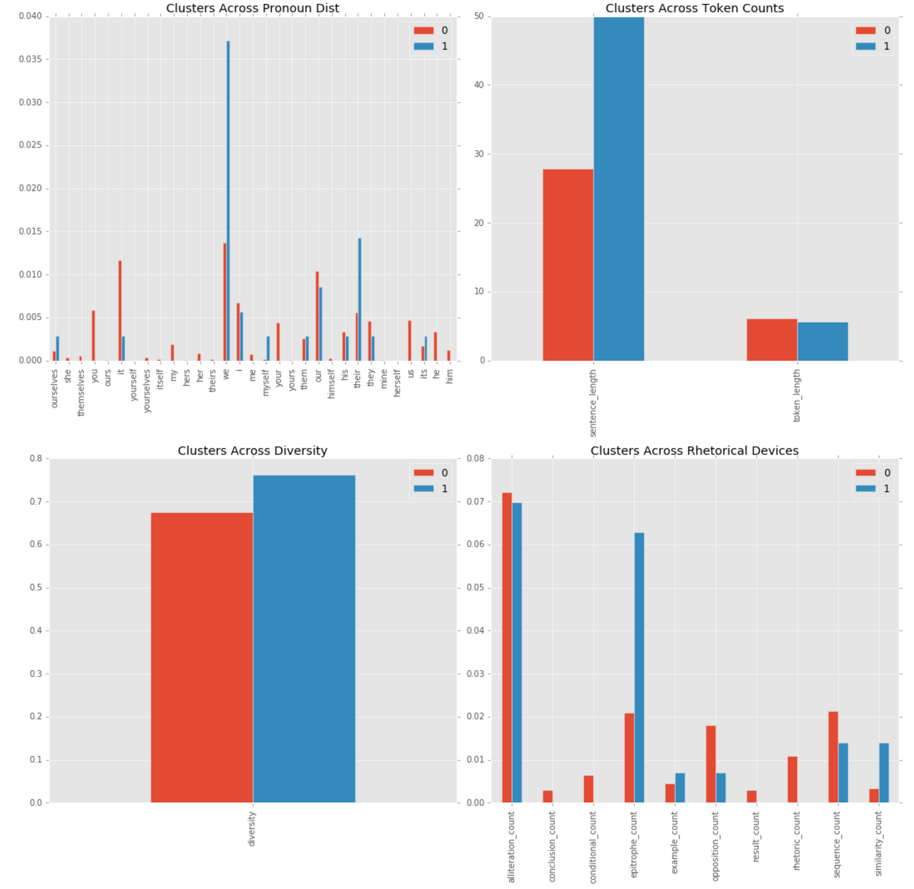
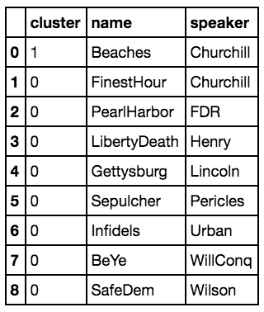
War and Peace
Churchill’s beaches is still very much on its own, and it really looks like it is because of the sentence lengths and epitrophe, and we.
Story: Churchill’s State During Speech

Slide 65
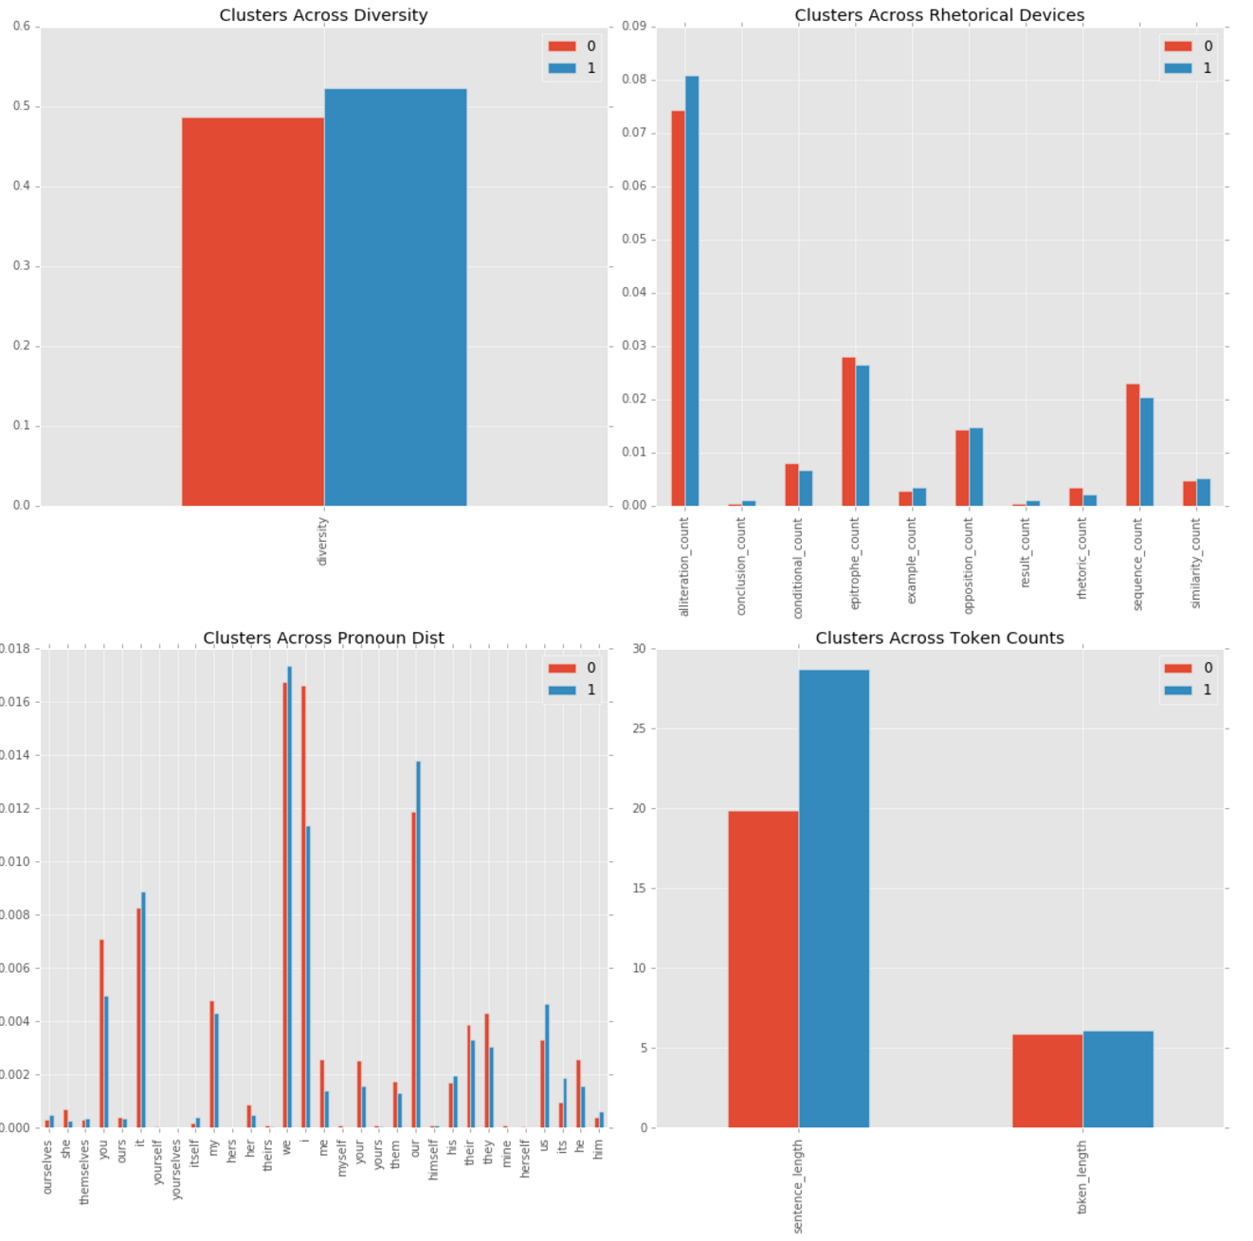
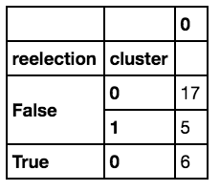
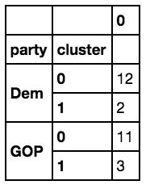
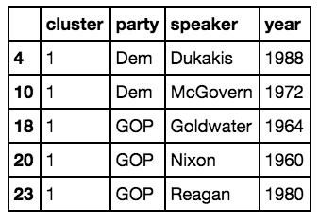
Presidential Nominations
Cluster 0 Highlights
Shorter sentences
Greater use of I and you
Cluster 1 Highlights
Greater use of our and us

Slide 66
What We Have Covered
Tokenization
Text Object
DataFrames
Ngrams
Stemming/ Lemmatization
POS Tagging
Feature Extraction
Basic Analysis of Results
Basic Domains of Linguistics
Rhetorical Devices

Slide 67
What We Did
Acquire
Prepare
Analyze
Act

Slide 68
What Next?
Comparing mediums (written speeches (think Plato) vs oral)
Looking at meter (phonetics, delivery)
More work with semantics
Getting speech ratings in order to determine most important parts of a ‘good speech’
We mostly just used famous in this one
Getting around to the dialogue piece

Slide 69
Questions

Slide 70
Backup Slides
Stuff we almost talked about

Slide 71
How Are We Going to Do This?
Get a speech
Find fun patterns!
Get words out of a speech
Extract features about words
Extract features about sentences

Slide 72
NLTK is a leading platform for building Python programs to work with human language data. It provides easy-to-use interfaces to over 50 corpora and lexical resources such as WordNet, along with a suite of text processing libraries for classification, tokenization, stemming, tagging, parsing, and semantic reasoning, wrappers for industrial-strength NLP libraries, and an active discussion forum.
Brought to you by http://www.nltk.org/

Slide 73
Morphology Sources
http://ocw.mit.edu/courses/linguistics-and-philosophy/24-900-introduction-to-linguistics-fall-2012/lecture-summaries/MIT24_900F12_Morphology.pdf
http://www.ling.upenn.edu/~rnoyer/courses/51/Ling512011Morph.pdf
https://www.youtube.com/watch?v=syjbhT45J14

Slide 74
Phrase Structure
Sentence
Noun Phrase (NP)
(NP)
Verb Phrase
(Det)
(Adj)
Noun
Prep Phrase (PP)
Prep
Noun Phrase
(PP)
V

Slide 75
Tree Diagram
S
NP
Pronoun
VP
V
She sang.
(She) (sang)
(She) (sang)

Slide 76
Tree Diagram
S
NP
Determiner
VP
V
The pretty woman sang beautifully.
(The pretty woman) (sang beautifully)
(The) (pretty) (woman) (sang) (beautifully)
Adj
Noun
Adv

Slide 77
Tree Diagram
S
NP
Determiner
VP
V
The pretty woman sang to the crowd.
(The pretty woman) (sang beautifully)
(The) (pretty) (woman) (sang) (to) (the crowd)
Adj
Noun
Prep Phrase
Prep
NP
(to) (the crowd)
Determiner
N
(the) (crowd)

Slide 78
Syntax Sources
https://www.youtube.com/watch?v=n9168PgGHBc

Slide 79
Semantics Sources
http://disi.unitn.it/~bernardi/Courses/CompLing/Slides_10_11/28_10_10.pdf

Slide 80
POS Tagger (links to linguistics)
http://textminingonline.com/dive-into-nltk-part-iii-part-of-speech-tagging-and-pos-tagger
How are morphemes involved

Slide 81
Notebook 5
Making A Dataset

Slide 82
Exercise 2
Comparing Speeches

Slide 83
The Critics
How are speeches traditionally evaluated?

Slide 84
Some quote here about the power of speeches

Slide 85
Some Definitions
Speech
Orator
Rhetoric
A definition
A definition
A defininition

Slide 86
Mediums of Rhetoric
 | Body Language | Tone | Diction
In Person | X | X | X
Audio |  | X | X
Written |  |  | X

Slide 87
Types of Argument
Blame = Past
Values = Present
Choice = Future

Slide 88
What Makes a Great Speech?
Repetition
Metaphor
Emotion
Only a few main takeaways
Don’t be too formal
Keep it short
Be audience centered
Have a strong takeaway line
Use short words. Write short sentences

Slide 89
Rhetorical Devices: Sound
Alliteration
repetition of the same sound at the beginning of nearby words e.g. “what my wife wanted”, “her husband has had”
Assonance — repetition of the same vowel sound in nearby words
“how now brown cow”
Onomatopoeia — a word which imitates the sound of itself
“buzz”, “whoosh”, “meow”

Slide 90
Rhetorical Devices: Repetition
Anaphora
repetition of a word or phrase at the start of successive clauses or sentences e.g. Winston Churchill
“We shall not flag or fail. We shall go on to the end. We shall fight in France, we shallfight on the seas and oceans, [… many more …] We shall never surrender.”
Epiphora
repetition of a word or phrase a the end of successive clauses or sentences e.g. Emerson
“What lies behind us and what lies before us are tiny compared to what lies within us.”

Slide 91
Rhetorical Devices: Change Meaning
Personification
giving human qualities to abstract ideas, inanimate objects, plants, or animals e.g. “The trees called out to me.”
Metaphor
a comparison of two seemingly unlike things e.g. “Life is a highway.”
Simile
same as metaphor, but using either “like” or “as” e.g. “Life is like a box of chocolates.”

Slide 92
http://www.poynter.org/2012/10-rhetorical-strategies-that-made-bill-clintons-dnc-speech-effective/187705/
Contrast
Repetition
Inclusive language
Rule of three
Power of 1 (look for …)
Humor
Instructional language (look for verbs with no subject before at beginning of sentence)
Explanatory language
Q & A
Ending

Slide 93
Some Famous Orators
Very Old
Thomas Pain
Winston Churchill
Adolph Hitler
Martin Luther King Jr.
Barack Obama
Malcolm X

Slide 94
https://blog.monkeylearn.com/the-definitive-guide-to-natural-language-processing/
NLP deals with different aspects of language: phonology, morphology, syntax, semantics and pragmatics. And its worst enemy is called ambiguity. We are going to see different levels of analysis (I will set aside phonology since it’s less intuitive and needs specific background) and how NLP systems usually addressed them.

Slide 95
http://www.cs.duke.edu/courses/spring14/compsci290/assignments/lab02.html
Doing tdf/idf for similarity
Pick body of works by a single author
Thomas Paine?
http://www.ushistory.org/paine/ (four of his works)

Slide 96
Rhetorical Device Bib
http://users.wfu.edu/zulick/454/figures/tropesindex.htm

Slide 97
Natural Language Toolkit (NLTK)
pip install nltk

Slide 98
Study: Finding The Issues
Looking at presidential nomination acceptance speeches

Slide 99
Study: Clustering Speakers
Finding famous orators who speaking style was similar. (did any allegedly study each other?)

